Slide 1
Git Hub
Commands

Slide 2
Git Hub
git config --global user.name "Sam Smith"
git config --global user.email “sam@example.com”

Slide 3
Create a new local repository
git init
git status

Slide 4
Add files
git add -A

Slide 5
Commit
Commit changes to head (but not yet to the remote repository
git commit -m "Commit message"

Slide 6
Connect to a remote repository
git remote add origin https://github.com/firstmentor/pn1.git

Slide 7
Push
git push origin master

Slide 8
Check out a repository
git clone /path/to/repository
git push origin <branchname>

Slide 9
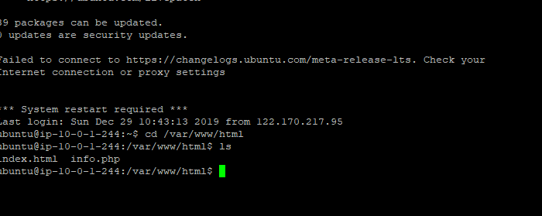
server

